Slide 1
SmartAUV Summer Project 2024
2024
Jouval Somer
Supervisors:
Ivar-Kristian Waarum & Kai Olav Ellefsen

Slide 2
Summer Project
Data processing/management
Visualisation
Matplotlib
ParaView
Nice way to access and interact with the data
Digital Ocean Lab

Slide 3
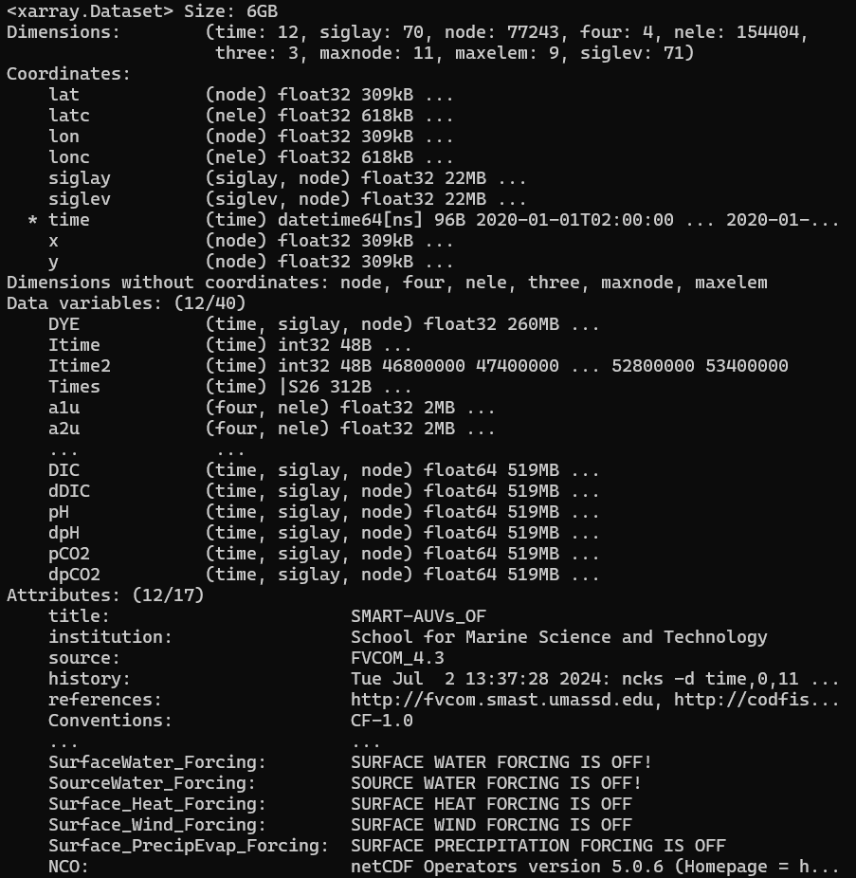
Initial Weeks
Started with trying to grasp and understand the data and its structure
Visualised as a line in ParaView
Data
Digital Lab
(Raw)
Visualisation
(Interpolated on a uniform grid)

Slide 4
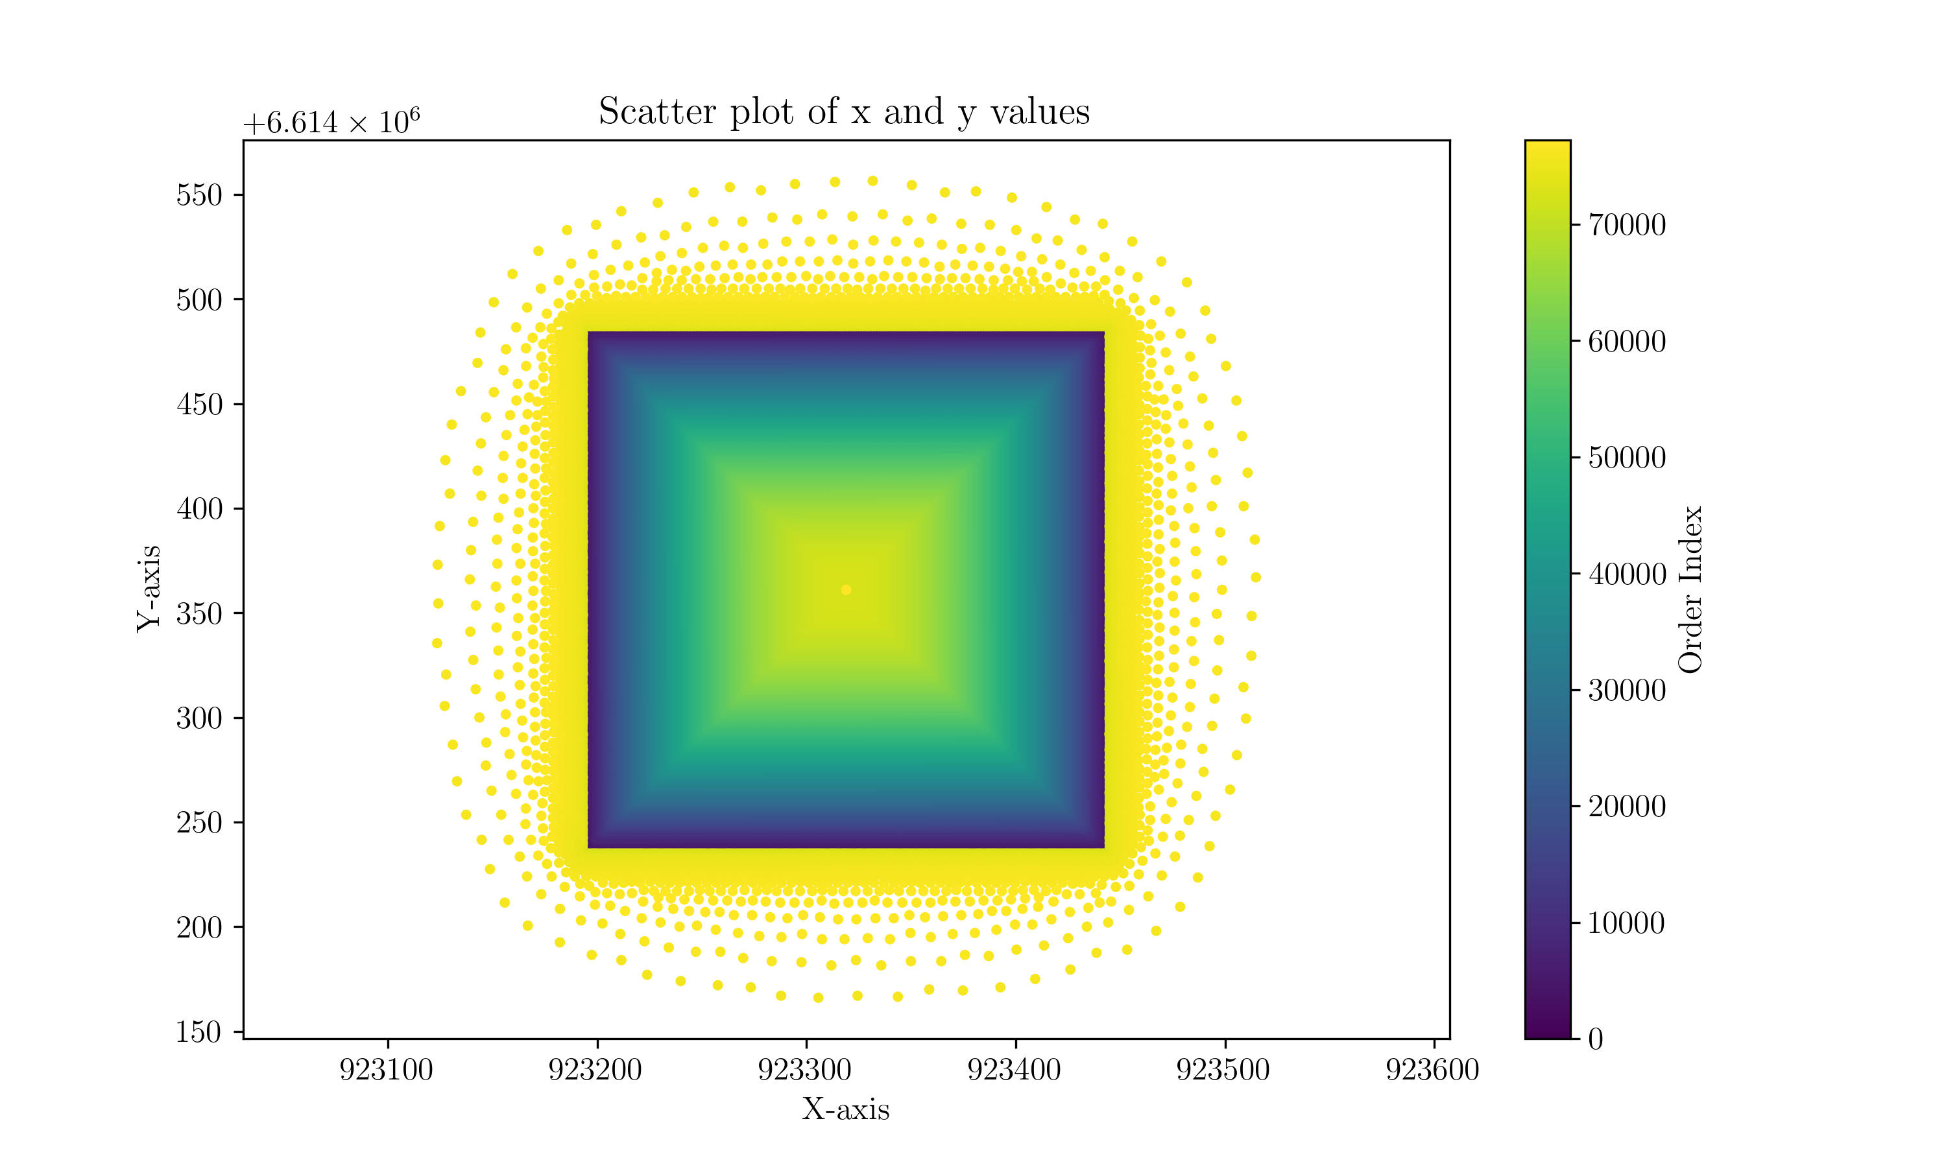
Datasets
Bubble Data
Comma separated file
Position (longitude, latitude, x, y, depth),
Time,
Mass,
Size, …
Oceanographic Data
Node structure
pH
pCO2
Velocity
Position (node/element)

Slide 5
Visualisation

Slide 6
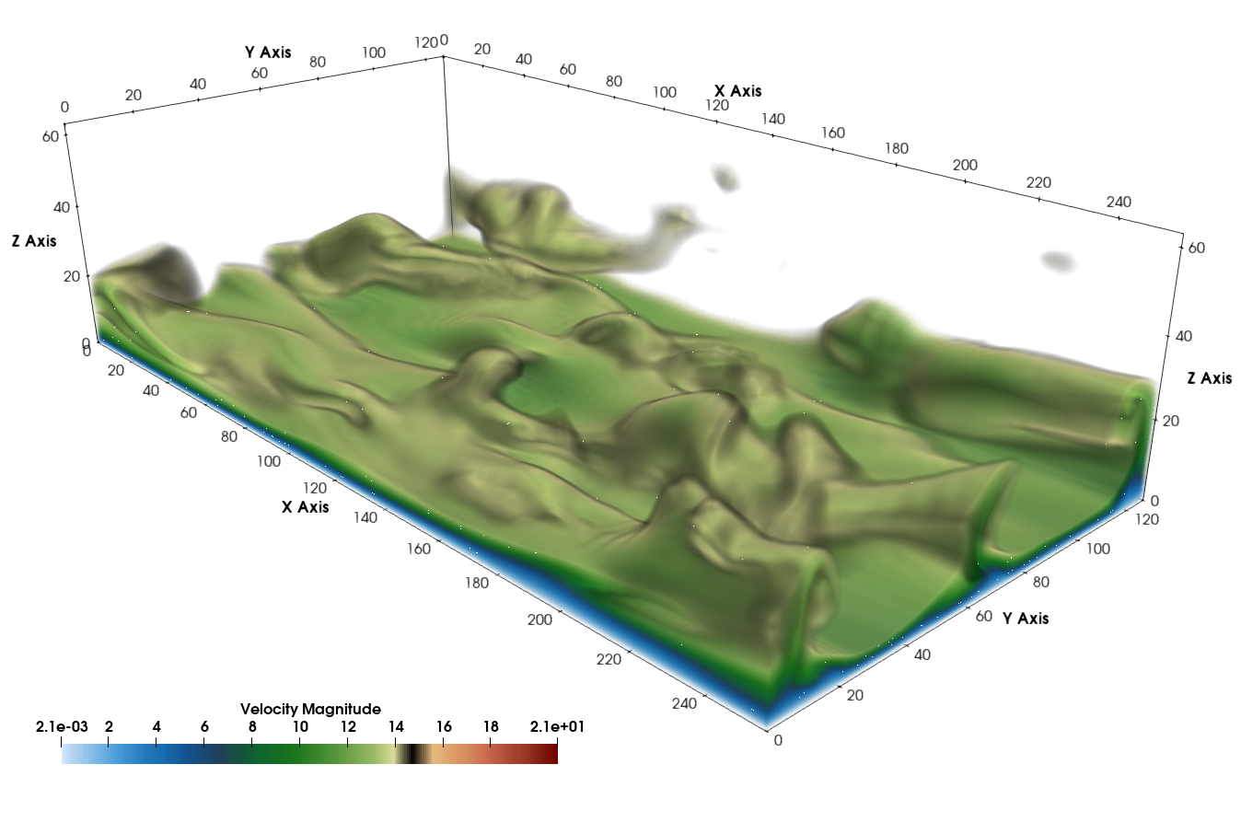
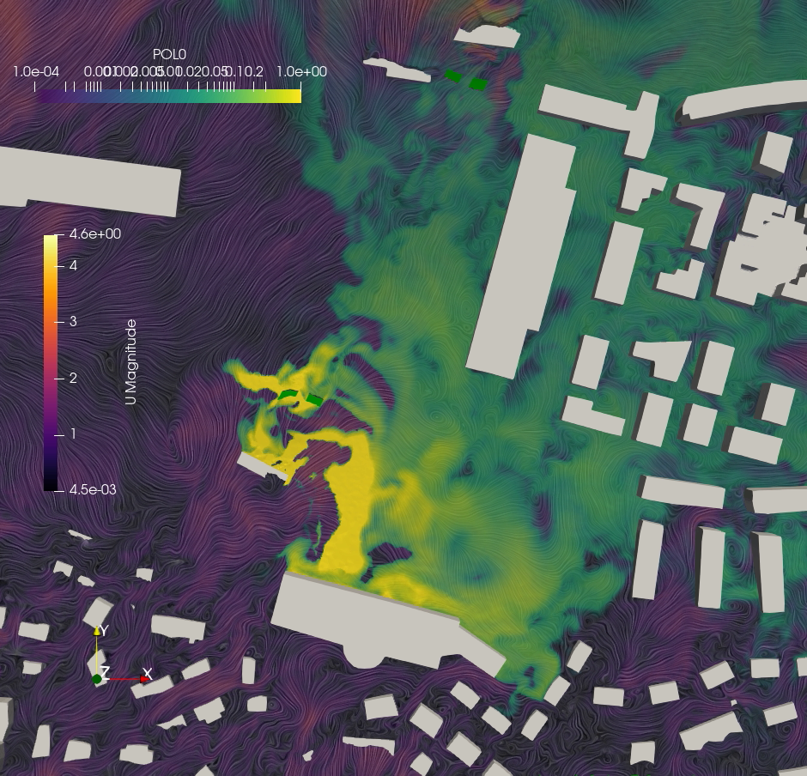
ParaView
What is ParaView?
Open-source, multi-platform data analysis and visualization tool.
Designed for qualitative and quantitative analysis of large datasets.
Key Features:
Scalability: Handles both small and large datasets, supports distributed computation.
Versatility: Supports various data formats and visualization techniques.
Applications:
Scientific Research: Used in CFD, climate research, material science, etc.
Engineering: Applied in simulations like stress analysis and structural mechanics.
Data Science: Enables big data visualization and complex data analysis.
Why Use ParaView?
Performance: Efficient parallel processing for large datasets.
Community and Support: Active user community, extensive documentation.

Slide 7
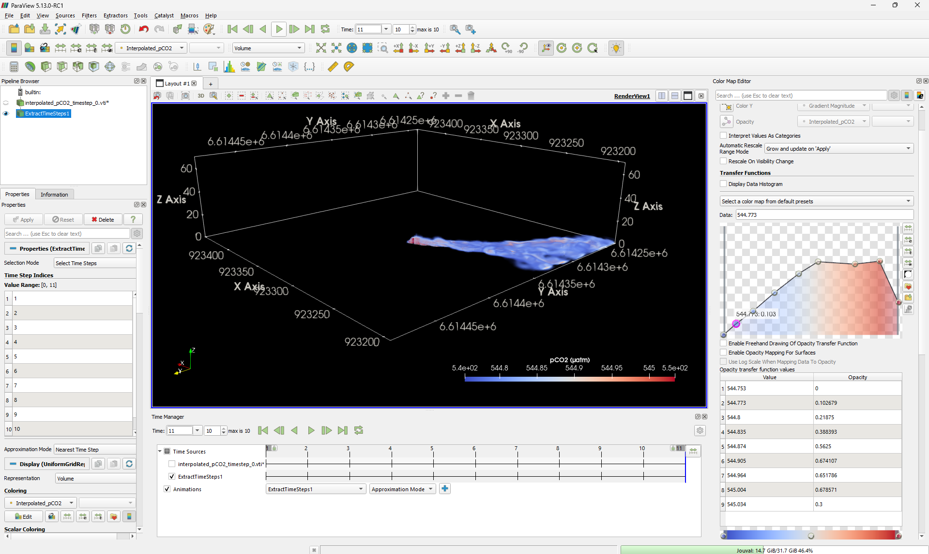

Slide 8
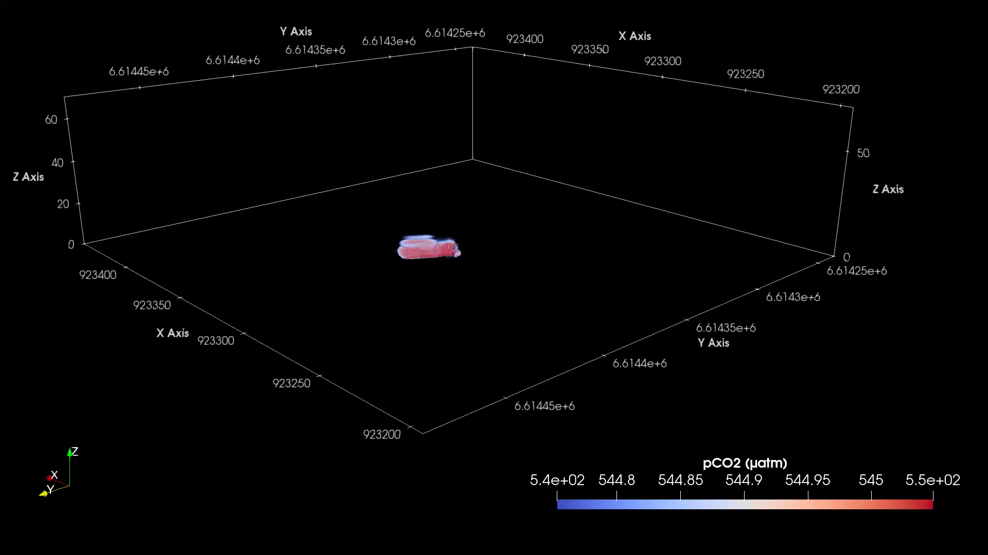

Slide 9
Digital Ocean Lab

Slide 10
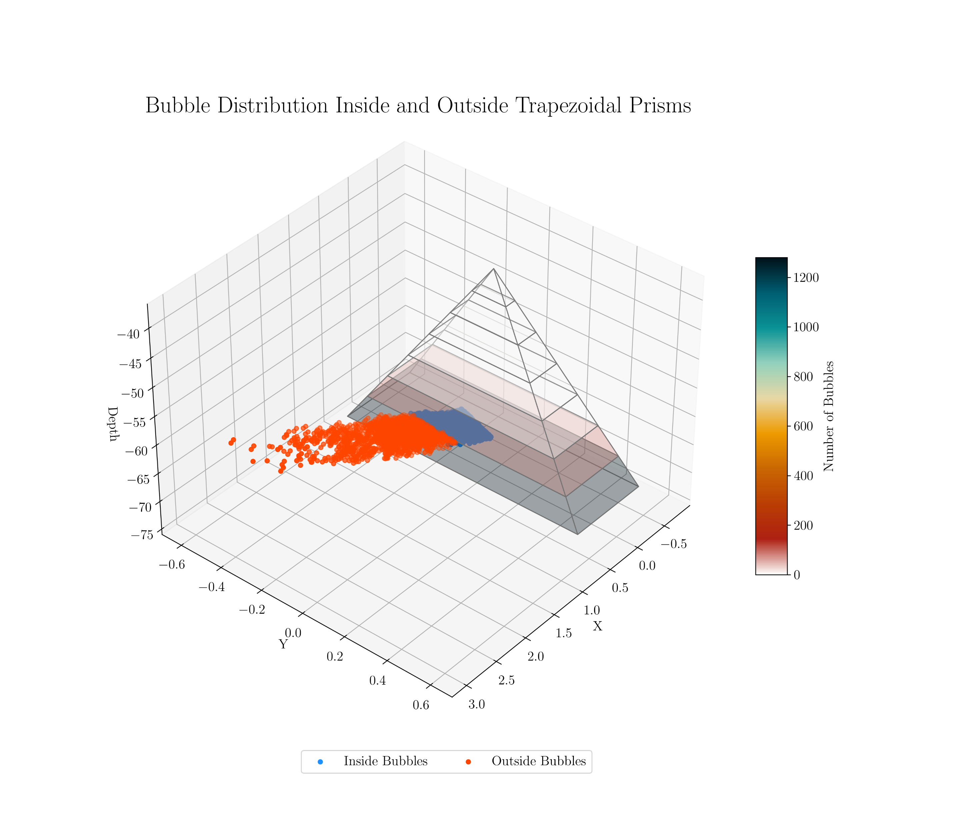

Slide 11
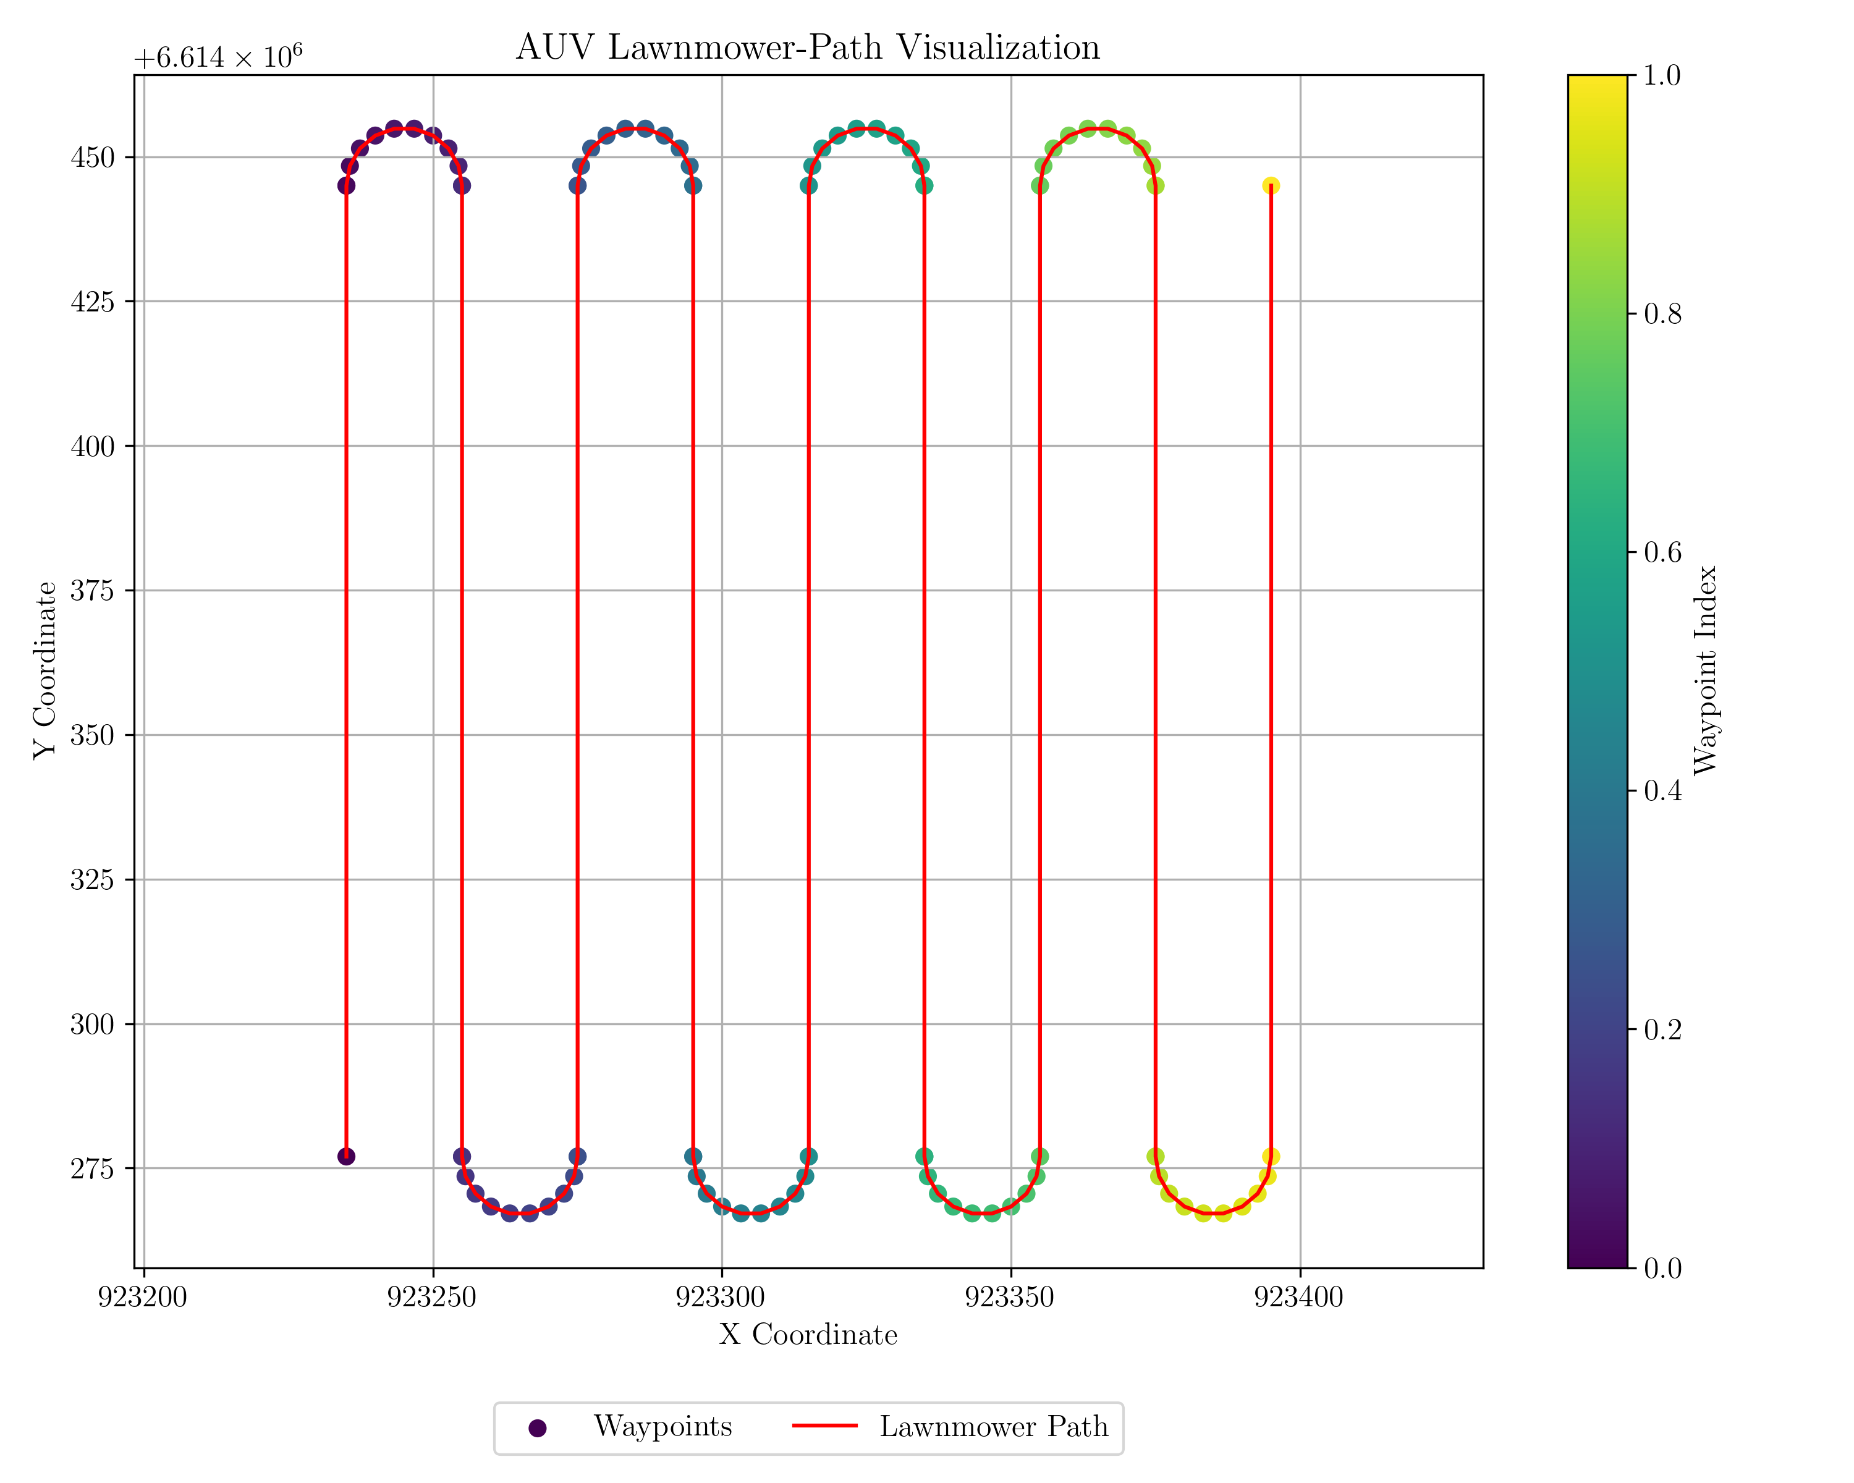
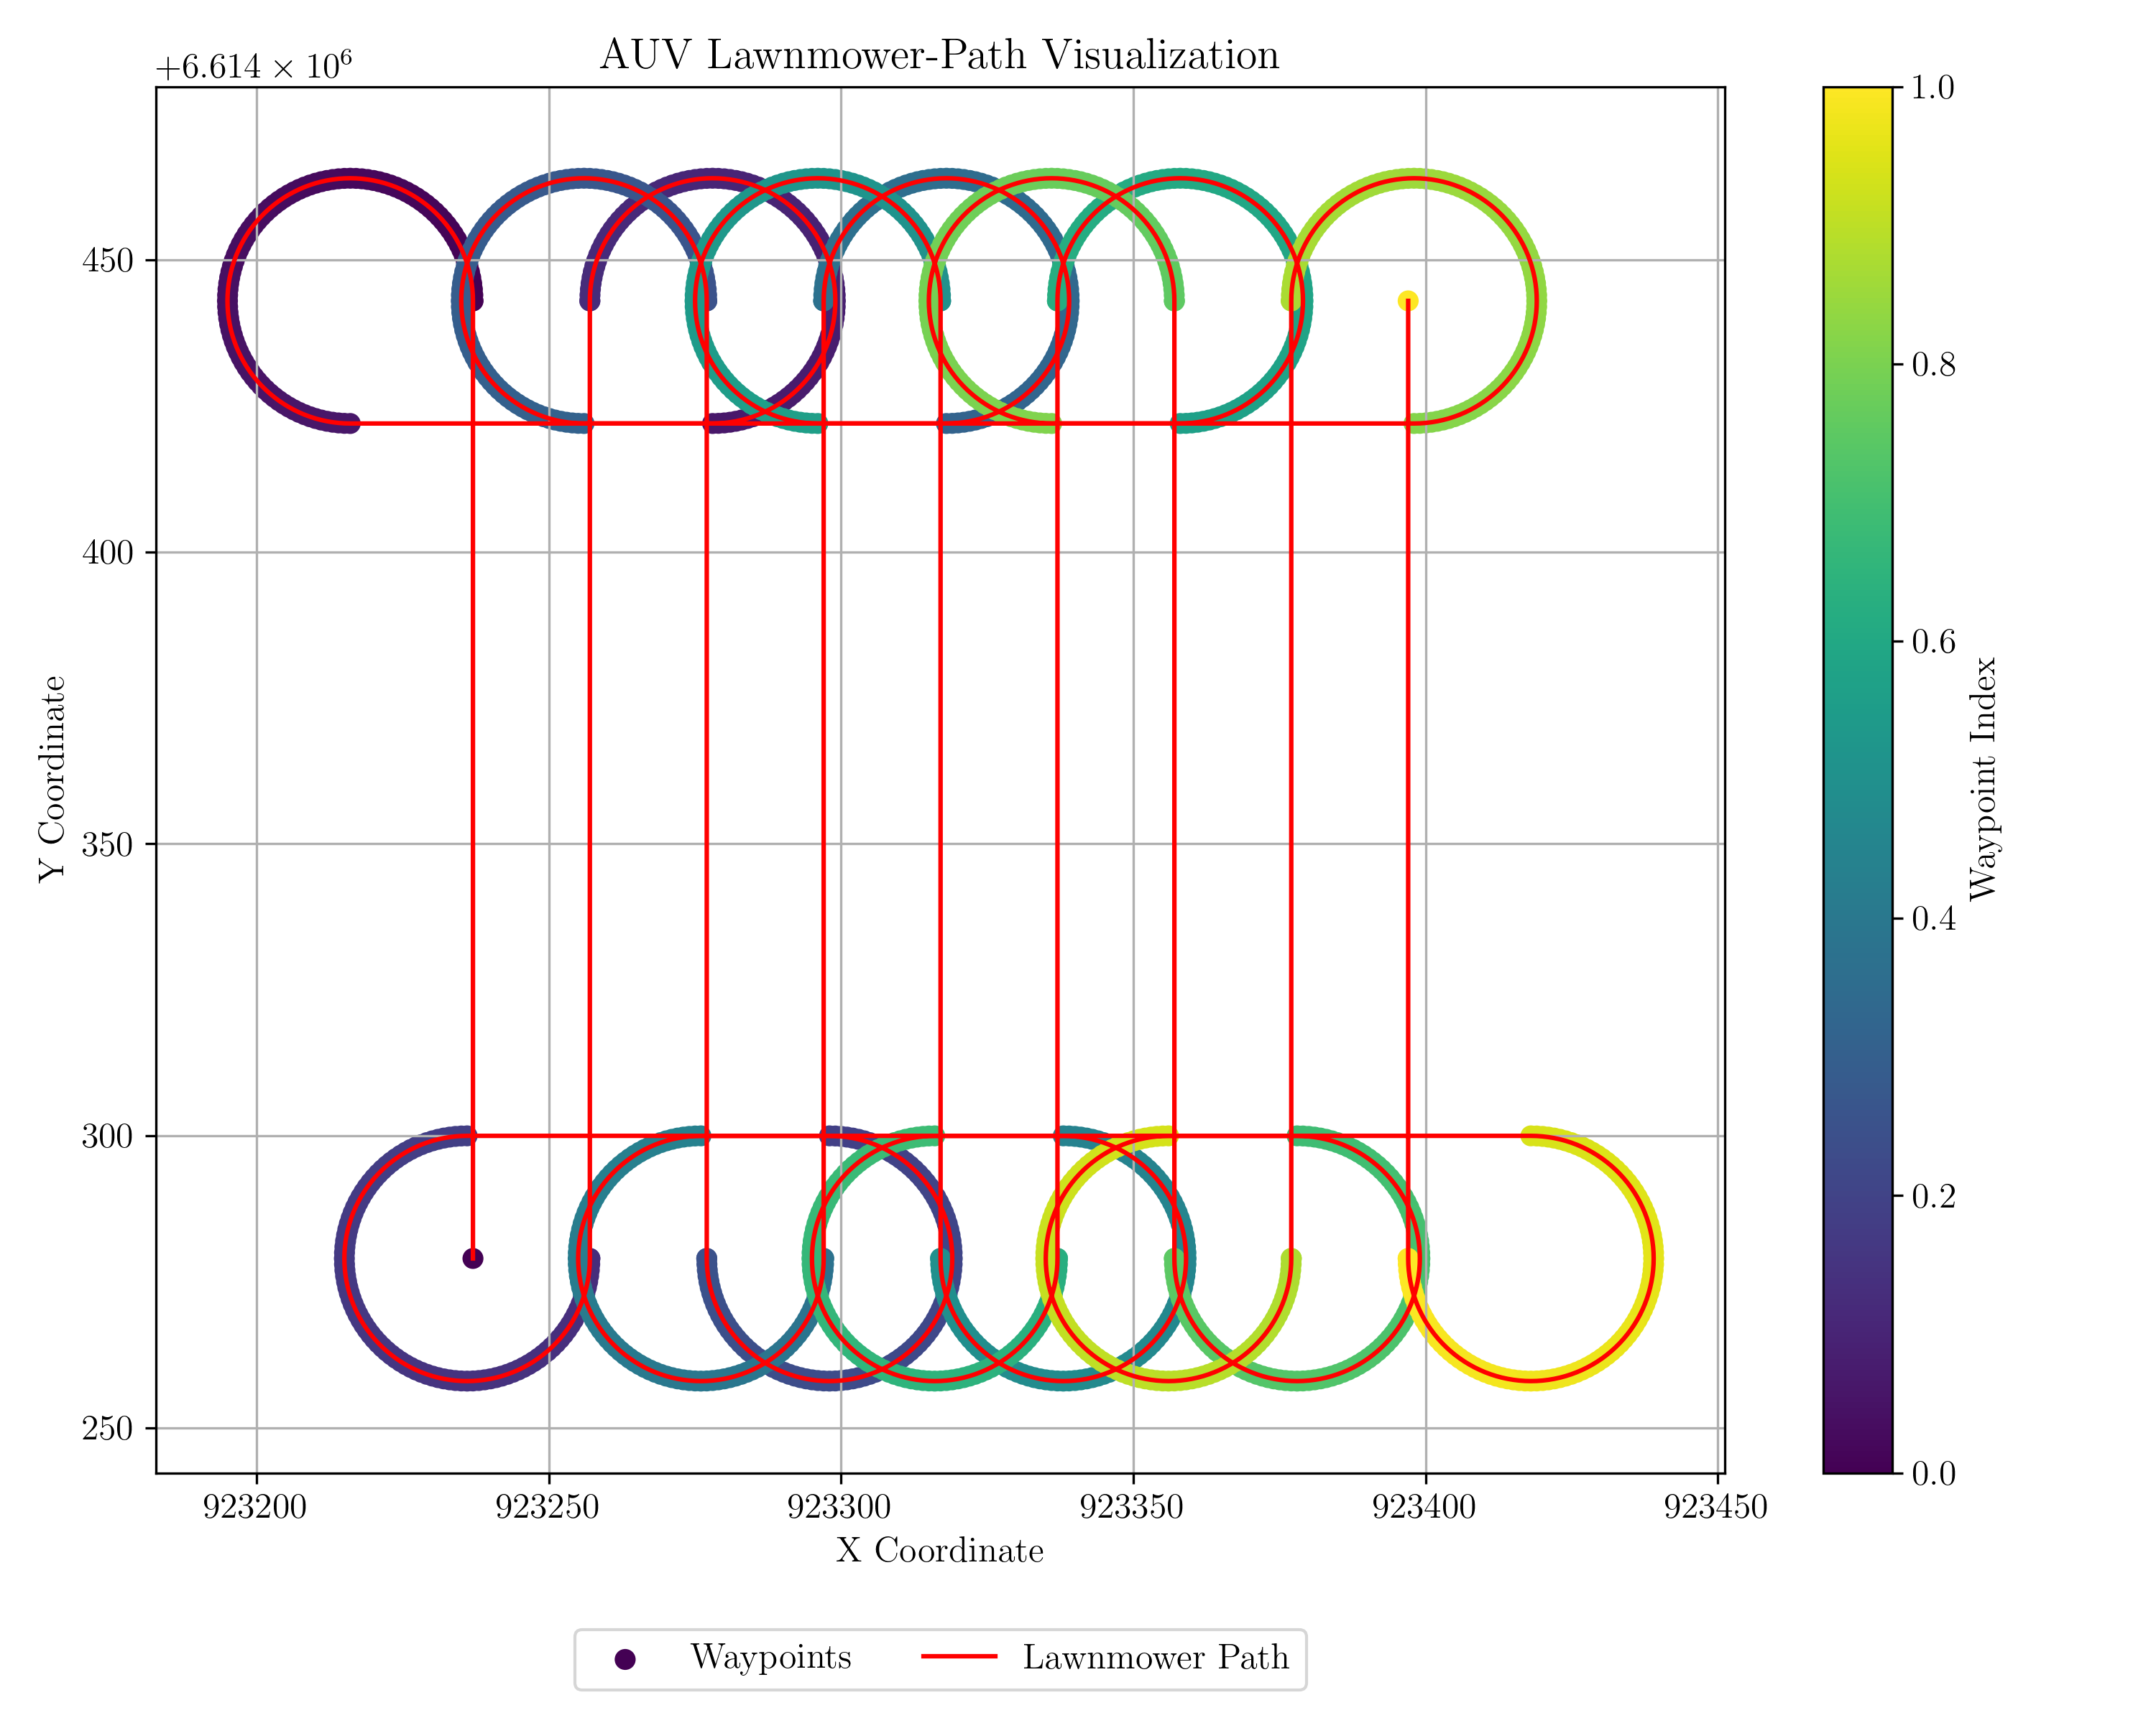
AUV Lawnmower-Path Visualization for different bar width and min. turn radius
Distance between parallel bars = 20
Minimum turn radius = 5
Distance between parallel bars = 20
Minimum turn radius = 21

Slide 12
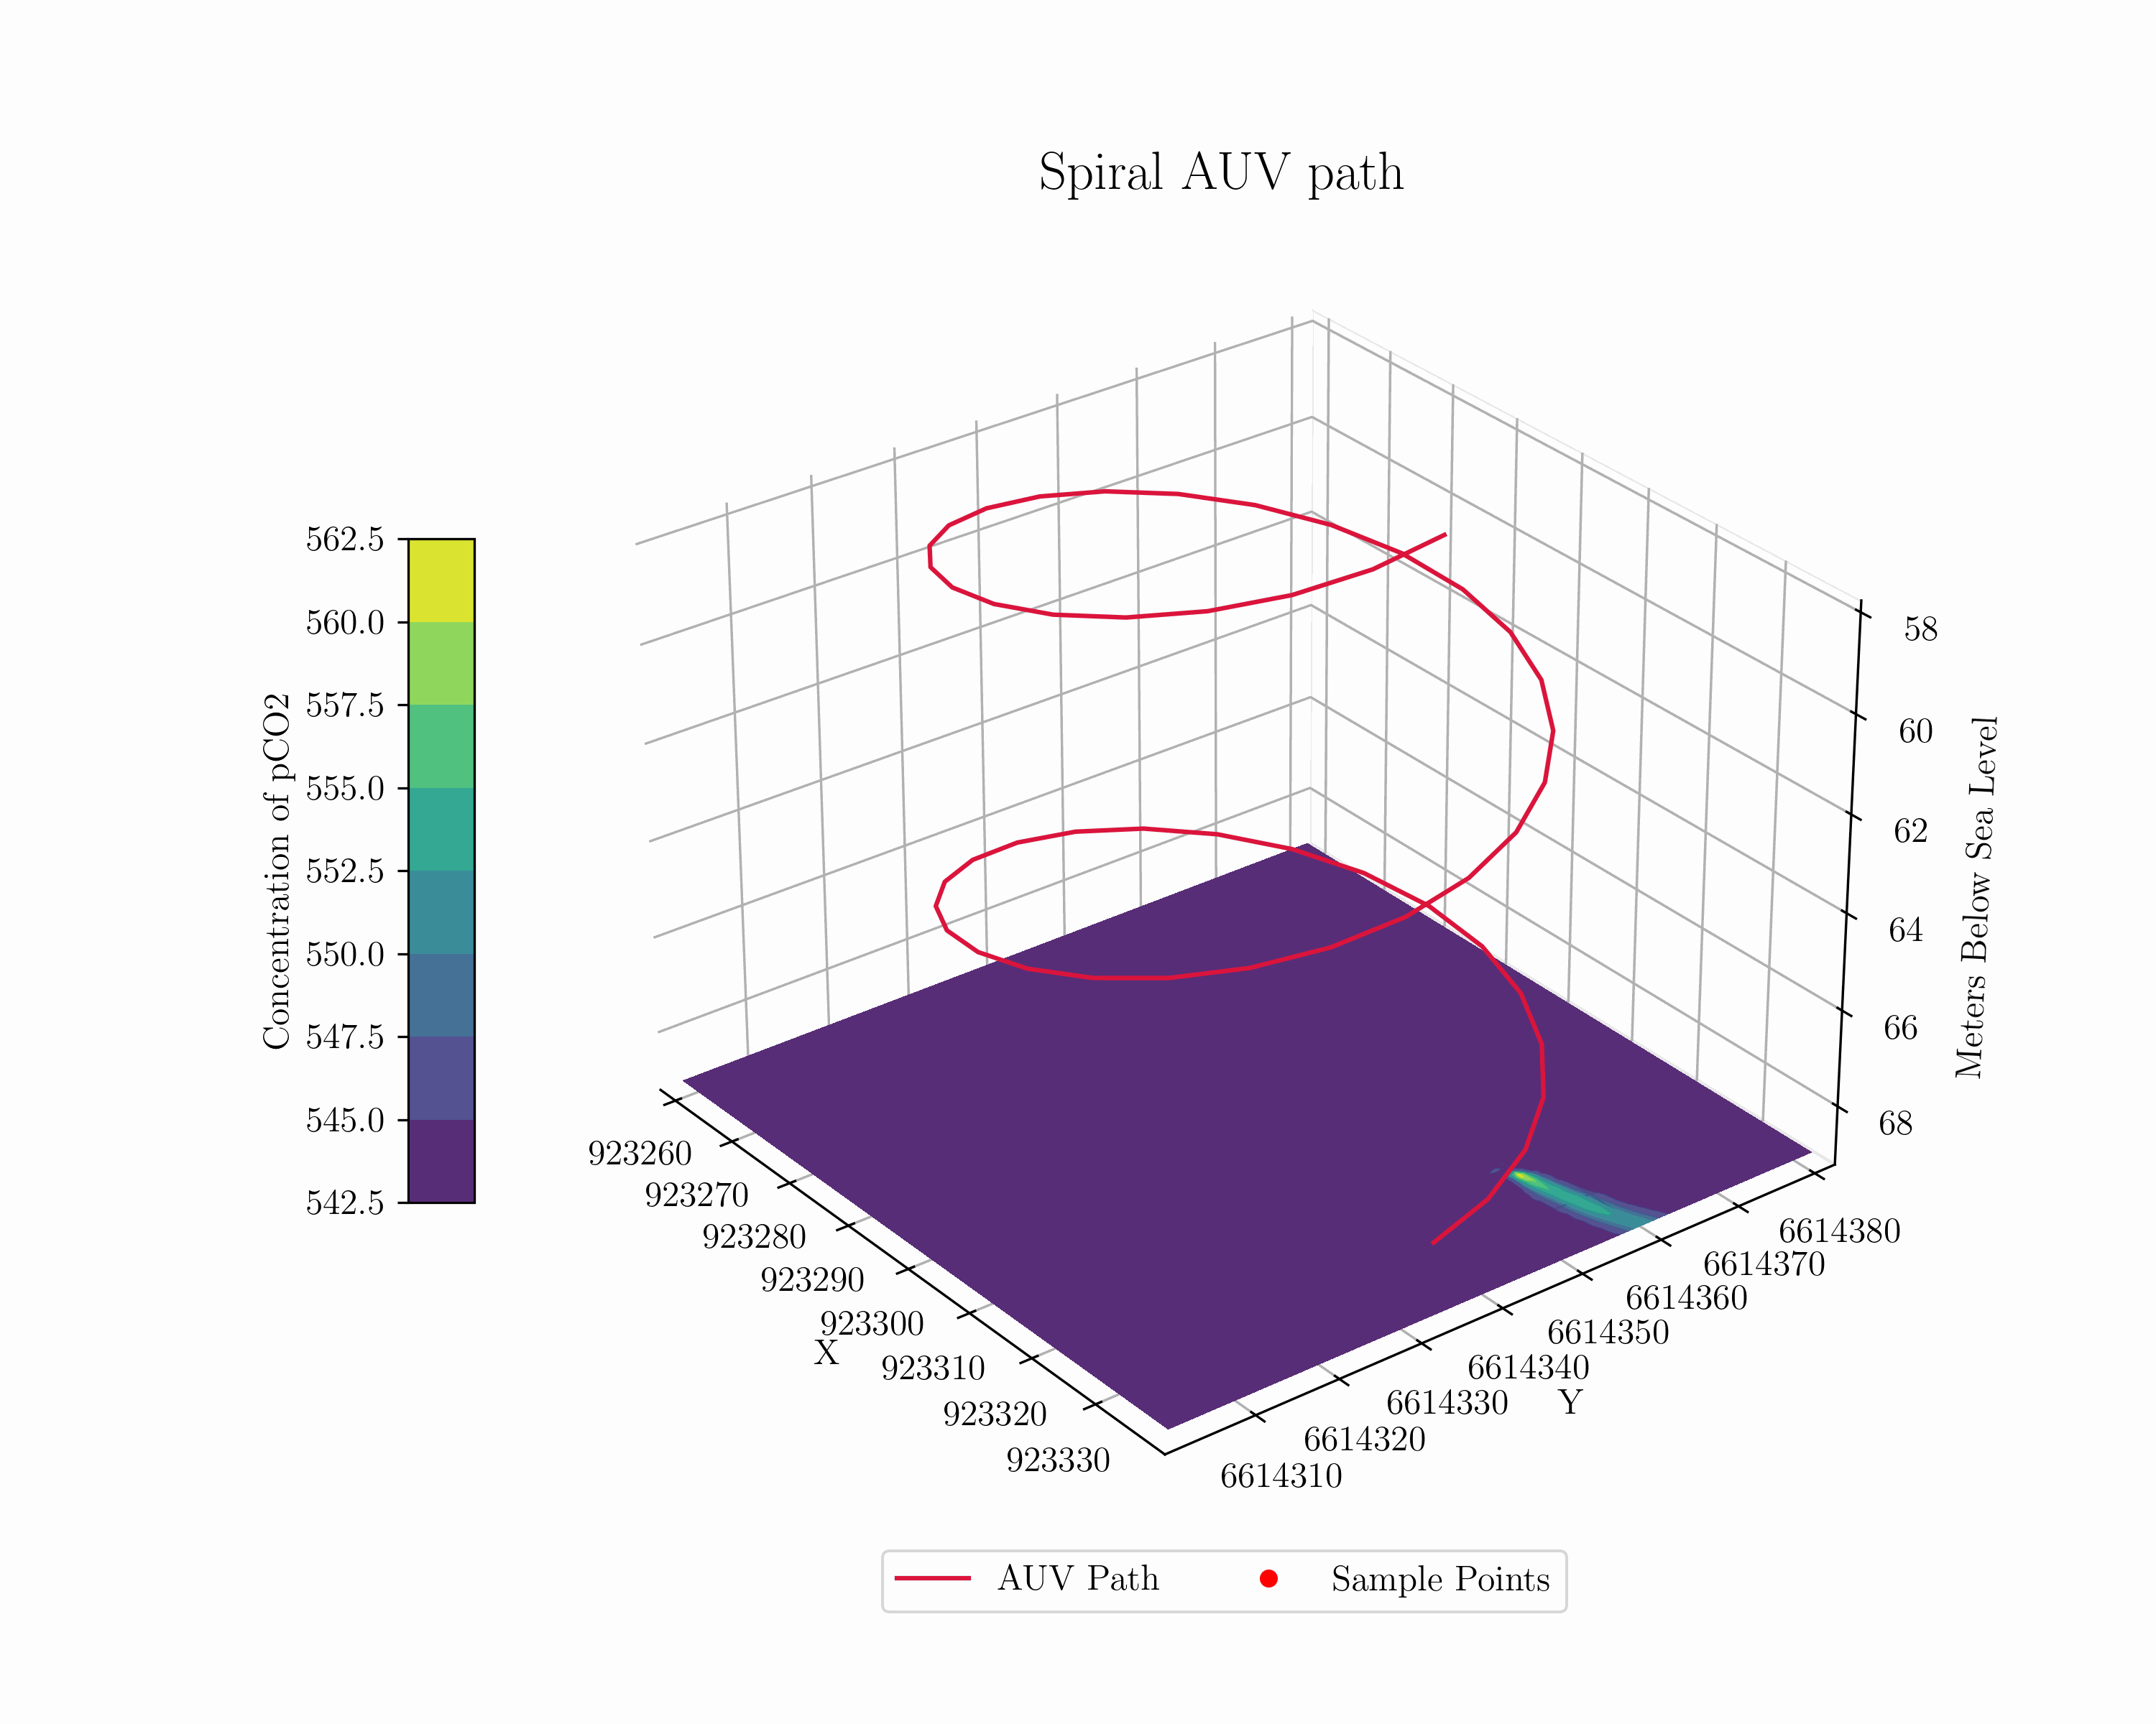

Slide 13
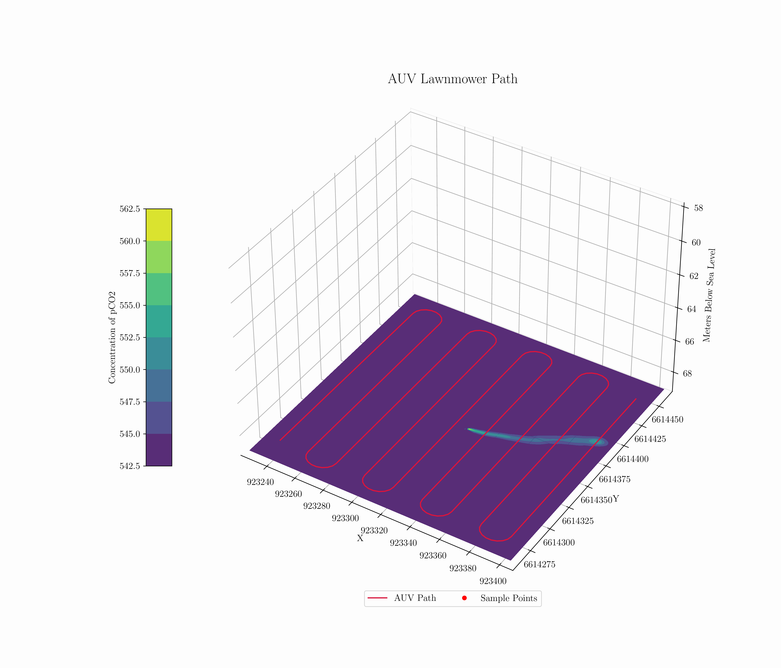

Slide 14
